Slide 1
Database DevOps
Section 1

Slide 2
1.1 - Overview

Slide 3
Title slide?

Slide 4




Steve Jones
SQLServerCentral Founder
Redgate Software Evangelist
www.voiceofthedba.com
sjones@sqlservercentral.com
@way0utwest
/in/way0utwest

Slide 5
Course Structure
This course consists of
Lectures and videos of course material
Assessment questions after each section
Hands on labs for you to practice skills

Slide 6
Course Overview
In this course, you will learn how to:
Define DevOps
Identify the challenges of database DevOps
Include your database code alongside other application code in source control
Setup a Continuous Integration (CI) platform for your database code.
Write and include automated unit tests for your database code.
Develop an automated release process that deploys database changes
Understand the use of branching and merging for database code
Instrument and monitor the database after deployment

Slide 7
1.2 – What is DevOps?

Slide 8
What is DevOps?
“DevOps is the union of people, process, and products to enable continuous delivery of value to our end users.”
Donovan Brown
Microsoft Principal DevOps PM
From http://donovanbrown.com/post/what-is-devops
Notes:
DevOps is a term that has come to mean different things to different people. There are many descriptions of what DevOps encompasses, and how to implement a DevOps team or process inside of a company. However, I like the short description from Donovan Brown of Microsoft. On the screen we can see his quote that say "DevOps is the union of people, process, and products to enable continuous delivery of value to our end users."
I really like that definition as it shows that the ultimate goal of a DevOps process is to ensure we deliver value to our users. That's what we want to accomplish, providing something the users of our software, our application, find useful and valuable. Everything is based on delivering results.
How we do that isn't important, nor is there any one way to do accomplish our goals. We need to use our people working inside of some process, and with some products or tools. But we need to put those things together and ensure that everything works together to produce something valuable.
That's the goal of DevOps, and ultimately it involves as much a change in people and process as it does using some sort of tool or product. In fact, the people and process change is going to be more important, and certainly going to take longer than implementing any tool.

Slide 9
What is DevOps?
“It is very important to realize that DevOps is not a product. You cannot buy DevOps and install it. DevOps is not just automation or infrastructure as code. DevOps is people following a process enabled by products to deliver value to our end users.”
- Donovan Brown
Notes:
There's another part of that post that I want to also quote. It says:
"It is very important to realize that DevOps is not a product. You cannot buy DevOps and install it. DevOps is not just automation or infrastructure as code. DevOps is people following a process enabled by products to deliver value to our end users."
The important thing to understand as we go through the rest of this course is that the goal of each part of this definition is important. While I will show some products and tooling, from both Microsoft and other companies, these products are just one way to accomplish the goal. Whether this is using git to manage our code or deploying automatically with VSTS, there important concept is that you understand how to manage code or deploy code.

Slide 10
The Three Ways
Gene Kim of The Phoenix Project and The DevOps Handbook, lists three core principles of DevOps
Systems Thinking
Feedback Loops
Culture of Continuous Learning and Experimentation
Notes:
There are three main principles of DevOps, as documented by Gene Kim. Mr. Kim is a entreupeneur and researched best known for authoring The Phoenix Project and the DevOps Handbook. He postulates that these principles should guide you in your DevOps journey.

Slide 11
The First Way: Systems Thinking
Dev
QA
Prod
Architects
Developers
QA
DBAs
And
Operations
Customers
Notes:
First is Systems Thinking, where we look at the performance of the entire system. We can't optimize or just look at one department or silo. We can't look at developers as more important from operations or testers. We need to consider the entire system from end to end to ensure we are not optimizing one part at the expense of others.

Slide 12

The Second Way: Amplify Feedback Loops
Development
QA
Operations
Notes:
The second way involves ensuring that information about effects is always passed back along the pipeline. This is often known as "shift left". In this case, we want to quickly let the left side of our pipeline, the developers, know if something is producing value or not. We want to let them know if they are slowing down the software deployment process in some way. We want to ensure that as they change anything, we give them feedback quickly. An example of this is letting developers know quickly if the code they checked in will cause any problems with other developers' code.
We also want to amplify the feedback loop so that information is not lost. Both developers and operations must communicate here and ensure that as we improve our process, and people get busy, that we don't let information slip by. Operational DBAs are notorius for making change in production to improve the performance of code, but not telling developers why. Not only can this cause potential conflicts with future deployments, but this also doesn't help developers learn to produce better database code. We want to ensure in the second way that developers get the feedback they need to raise the quality of their software over time.

Slide 13
The Third Way: A Culture of Continual Experimentation and Learning
Development
QA
Operations
Notes:
The last way is the key. Everyone must look to learn more about the system and their craft, experimenting with new ideas. Without a doubt, some of these experiments will fail. However, we want these to fail fast and with limited impact. Ideally, our failures take place in non-production environmenst. However, we always learn, and ensure others learn, from our efforts.

Slide 14
Notes:
These diagrams show that the flow from left to right, with feedback occuring from right to left. We really have a loop, and in the world of databases, I think a loop presents a better image for our technical journey. Here is a flow of our database development, going in a circle. We start with our developers, we move to a build of our system, then testing, then packaging our changes up for release.
That's what we'll cover in this course. The rest of the technical side, monitoring, backups, and provisioning new systems is important, but it won't be covered here.

Slide 15
1.3 – Challenges

Slide 16
Why are databases different?
“It Depends”
Some code is (almost) the same (views, stored procedures, functions)
Some code isn’t (tables, indexes, security)
These structures maintain state
They can be cumbersome to change
Versioning might not work
Notes:
In this section, we want to talk about the challenges of including your relational databases in a DevOps process. Is there a fundamental reason why database code if different from application code?
The answer is the classic “it depends”, a common phrase used in database work. There are reasons why some database code is different and some is the same. In a SQL Server database, we have a variety of different objects. We have tables, views, stored procedures, functions, assemblies, indexes, constraints, and more. Of these, some are code just like your C#, Visual Basic, Java, Python, or other application code. Some aren’t.
The objects that are like application code, the views, stored procedures, functions, and assemblies, can be treated just like application code. Deploying a new version of this code, or restoring an old version, is very similar to deploying a new version of the application code. We can switch back and forth, compiling various versions without impacting our database. Of course, the logical effects of the different versions migh t be problematic, but this is the same as replacing a method in one of your classes with a different version.
If you only ever need to change your view, stored procedure, and function code, then including your database in a DevOps process is easy. You can even automate the rollback of one version to a previous one. The process would be slightly different as the rollback process needs to recompile an old version in the SQL Server database, as opposed to copying the previous version of a .DLL or .EXE, but this are just implementation details. Fundamentally, the process is the same.
However, for tables and the associated objects, such as indexes or constraints, the code is different. The reason is that these objects need to maintain state between versions. The state is the data, and we cannot just delete and replace the objects with new, or old, versions. We might incur data loss, and that is almost always a problem for an organization
The need to maintain state can cause multiple problems. First, changes must account for the state of the system and cannot cause data loss. This means no destructive changes. We must ensure our alterations of these objects are evolutionary. Second, because we need to ensure our data is intact, even as a deployment might cause a transform, we may have difficulty performing a rollback of changes. We’ll look at an example of this later in the course.
Lastly, the database is often a common access point for multiple applications or systems, which means that changes can impact multiple processes. Either we must provide forward and backward compatibility, which brings up integrity and performance issues, or we must coordinate changes across multiple development teams. This need for tight coupling is fundamentally at odds with the idea of loosely coupled, contract or API based DevOps methodologies.
These are core issues with including a database in a DevOps process, but there are other challenges with databases that are less technical, which we’ll cover in the next module.

Slide 17
1.4 – Non-Technical Challenges

Slide 18
Non-Technical Challenges
Different staff responsibilities
Change and improve v stability and performance
Liability for issues
Staff Knowledge
Fundamental nature of code management and deployment
Habits for working with systems
Data Challenges
Data migration between environments
Data changes between environments
Drift
Notes:
While the need to maintain state for our data is a technical impediment to including a database in a DevOps process, there are many other issues that development teams encounter when they look to include a database in their development process.
One of the main issues is with the people in charge of the production databases. Often traditional DBAs that manage databases aren’t familiar with software development tools and techniques. Just like sysadmins often need coaching to understand how version control and scripted build or release servers work, so do DBAs.
However, it’s not just a lack of understanding of the tooling, but also a fundamental tension between the goals of developers and the goals of a database administrator. Just as sysadmins are more concerned with security, stability, and performance of the production systems than the features in an application, DBAs have similar concerns. The DBA may, in fact, be even more concerned about rapid change as the database is a single source for data, with some changes not easily rolled back. Unlike web servers and application servers, having to remove changes from or restore a database is extremely disruptive.
## Challenges with Managing Data
Another issue that teams often face is the fact that some of the data in a database is really a part of the development system, and needs to be migrated along with code changes. For example, there will be lookup or reference data (also called static data), that should be synchronized across all environments from development to production. This may be information from official sources, like lists of cities and postal codes, or this might be application specific, such as status values or gender options.
This isn’t technically too hard to manage, but it is a challenge that companies need to address. The administration of determining the official source of data and ensuring that correct sets are distributed to each database in all environments can be an issue.
The last issue is perhaps one of the most problematic. When there are issues with databases, often performance related, DBAs or sysadmins might make changes to code on the production server. Sometimes these are index changes, but perhaps stored procedures or views need to be changed with hints or other code tweaks to help them perform better. The need to expediently correct issues is often the driver for causing this “drift” from the last official release of database code.
Often these changes aren’t fed back to the development system, which means that future development code might not deploy correctly

Slide 19
1.5 – ORMs?

Slide 20
1.6 – State v Migrations
Notes:
There are two philosophically different ways of dealing with database development. These are state based database development and migrations based database development. Each of these work well and can be used for most of your database development. Each also has flaws or limitations that you may need to work around.
In the next two sections, we’ll look at how each of these two development models works, along with the advantages and disadvantages that you may face when using either of them.
Note that we will explore the issues of development related to relational databases that typically allow various types of code inside of the platform. Various other types of databases, such as document databases, graph databases, etc., are not discussed in this course.

Slide 21
State Based Database Development
Capture the “state” of all code at a point in time (a snapshot)
Compare this state with another version of this state
Can be database to database
Can be VCS to database
Use the comparison to generate a script that will deploy changes from one version to the next.
Notes:
A set of database code exists in a state at any point in time, just like any application code. However, unlike application code that can be completely removed and rebuilt, parts of a database must be transitioned from one state to the next. This is true of tables, but potentially other objects in relational database systems.
As a result, we cannot just compile the new version of code in the database. Instead, we need to provide transitional code that will change the state of the code.
In a state based development system, we use some sort of comparison method to examine the current state of a database (or code in a version control system) and compare that to another version of the database (or version control), and generate the SQL code required to migrate objects from one version to the next.
The typical flow for this is to make changes in development and then perform a comparison with the version of the database in a downstream environment, such as production, and then generate a script to transform the downstream environment to look like development. In essence, we generate a script to “deploy” our code. Let’s look at an example.

Slide 22
State Based Database Development
Advantages
Simple for developers, nothing to track
Transient changes (those not needed) are not transferred
Branching and merging is (relatively) easy
Disadvantages
Some changes cannot be captured with snapshot comparisons
Upgrades of databases tend to require known starting/ending points.
Multiple versions of databases are not easily upgraded
Notes:
There are good things with using state. One is that developers can make changes, undo them, make new changes, and never worry about tracking those changes. When the developer feels that development is complete, they can run a comparison tool and determine what changes need to be sent to the downstream database. This simplifies database development as it occurs.
The other advantage is that any changes which are made in development and then discarded are never transferred to downstream environments. Since the deployment of changes can take time, and sometimes significant time, this speeds up the deployment of database changes. I have worked with some schema changes that take minutes or even hours to complete on large tables. Avoiding making a change and then undoing the actions can be very important in today’s world where downtime must often be avoided.
However, even meta data changes to objects like views and stored procedures can be problematic if there are multiple changes made over and over to the same object.
This might seem to indicate that state changes are preferred, but that’s not always the case. Let’s look at a couple of potential database enhancements. Suppose we decide to rename a table. Let’s change the name of the table “Status” to “StatusLookup”. This is a more descriptive name and a common type of refactoring we might do in a C# method, but one that can be problematic for databases.

Slide 23
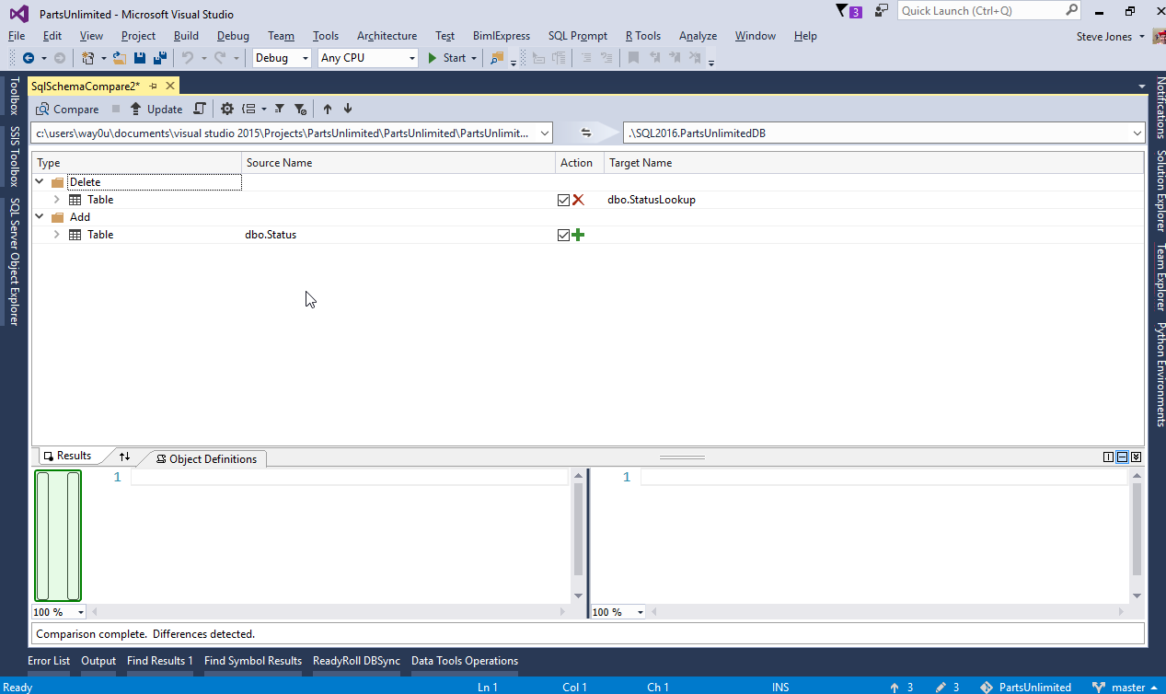
Notes:
Depending on the process and tools we use to do this, we could get different results. If run a state comparison, we would typically see the view from the SSDT comparison.

Slide 24
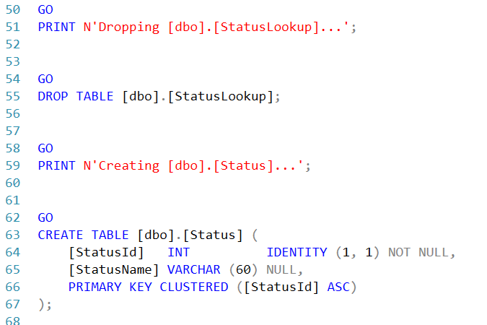
Generated script for table rename
Notes:
(slide)
As you can see, the comparison detects this rename as a drop of one table and an add of another. The script to perform this action would look like this:
This is not what we’d like to have happen if there is any data in the original table. Instead, what we would prefer is that the same rename operation that the developer executed is what is placed in the script. In order to do this in a state based database deployment, we would have to edit this script and include custom code that executes the sp_rename function.
One note, SSDT and Redgate's SQL Compare typically detect these rename operations. However, if developers or other tools are used, we could run into this situation.
A similar issue occurs with other database operations such as a column split. If we create new columns, we must also include DML code, Data manipulation code, that performs the data movement. This isn’t something a state based comparison tool will generate for us. In fact, there are a whole domain of problems that state based comparison tools cannot handle since there is no way to automatically determine how the objects actually changed.
Since we must maintain state for our table objects, this means custom coding must be written, tracked, and injected into the deployment process. This is a manual process that invites mistakes, something we seek to avoid in a DevOps process.
This does not mean that we cannot use a state based approach, but we must be aware of the places where state based comparisons require additional work. Fortunately, there are some products and solutions that provide the ability to inject additional code that allows certain operations to proceed. For example, Redgate’s SQL Source Control allows a developer to specify exactly how to handle code

Slide 25
Migration Based Database Development
All changes made to a database are tracked as they are made with the scripts stored in a VCS.
Change scripts are ordered and executed in the same order on downstream environments as they were in development
The actual code a developer executes is replayed in downstream environments without be rewritten or generated later
Notes:
State based comparison tools have not existed for that many years, and aren’t available for all relational platforms. Prior to state based tools, many developers use a migration based development approach as a way to implement a more cohesive, reliable framework for managing their database changes.
A migration based development approach requires that as developers make changes to their databases, they track each change (or set of changes) in a script. These scripts are then executed, or replayed against the downstream databases in the same order they were executed against the development systems. In this way, we can ensure that we don’t miss any of the changes made in the development environment, and we can easily move any database from one version to the next by applying the correct number of migration scripts.
Of course, this doesn’t necessarily reduce the complexity of database development. Tracking all the code from development still means that we need a couple of items to be in place. First, we need a way to determine in what order to execute scripts. Typically, we do so in fashion based on script name. This can be numerical or alphabetical, but we need some way to determine the ordering of our code. After all, we can’t build indexes before we’ve built the table, so executing code in order becomes important.
The second thing we need to know is which scripts have been executed. This becomes important when we look to integrate code from multiple developers, potentially to multiple databases, across time. Knowing that a script has been run means we never run it again against that database.
A number of projects and tools have sought to make this easier for the database developer. In Visual Studio 2017 Enterprise, one of these is included. The Readyroll Core edition, from Redgate Software, is a part of the Data Storage and Processing workload. Readyroll is designed to track all the scripts written with a development database and then execute them in the proper order against downstream databases later. The scripts are also tracked inside of each database, ensuring they are not executed multiple times.
Let’s see how this works in practice.

Slide 26
Migration Based Database Development
Advantages
The exact code is executed in all environments, ensuring repeatability and reliability.
Any version of a database can be upgraded to any other version
Disadvantages
Changes need to be tracked
Ordering is important and merging branches of development can be complex
Lots of scripts may need to be run, lengthening deployment
Production drift can cause lots of issues.

Slide 27
1.7 – State v Migrations

Slide 28
Building Better Collaboration
DevOps requires development and operations to work together.
This requires empathy for the other point of view.
We need to balance needs
Risk of changes
Advantages of deploying new code.
Notes:
#Better Collaboration
Historically there has been more tension between production database staff and database development staff than between other developers and sysadmins. Perhaps this is because the database must maintain state and contains the most critical data of an organization. Perhaps this is because most sysadmins don’t deal with systems that must maintain state across deployments. No matter why, DBAs have often been seen as an impediment to developers getting their features and changes deployed to users.
DevOps seeks to build more collaboration between everyone involved in building software. In order for both the production DBAs and developers to work together, each must learn to understand the needs of the other and modify the way they work.
This is a challenge in many organizations, and requires someone to step up and show empathy and understanding to the other side. My view is that the developers should start the process, since the DBAs (or other production sysadmin) is often concerned about changes that might cause irreversible damage to the database. If this happens, the DBA may need to restore the database, causing lots of downtime and upsetting many people in the organization.
A developer, however, can express their understanding of the challenges faced by the DBA by working together to limit the impact of changes, or understand the best way to make these changes.
Conversely, the developer needs to get work done, so the DBA should ensure that they are open to being more flexible when the changes aren't risky, such as stored procedure changes. DBAs can also work with developers to discuss how to make changes in a way that won't cause issues or how rollbacks should be structured.
DBAs can also be sure that they feedback any production drift changes, such as indexes, security changes, etc. to the developers to prevent future issues.

Slide 29
1.8 – Lab Setup

Slide 30
Hands On Lab
The lab for this course will walk you through the setup of a series of databases where you will implement a CI process, and deploy changes to downstream environments.
We will use these environments:
A local development SQL Server database
A local integration SQL Server database
A git repository, linked to a VSTS repository
A local QA database
A remote Azure SQL Database
Notes:
#Lab Setup
In order to follow along and perform some of these labs, this section will explain how to setup your database environment to allow you to proceed with future labs.
We will be using the PartsUnlimited database, which is created as a part of deploying the PartsUnlimited demo application to an Azure web application and Azure SQL Database. You can read about the process here, but in order to keep this simple and scoped to the database only, I have extracted the database as a .bacpac file you can use.
## Requirements
In order to complete the labs yourself, you will need the following:
* Visualstudio.com account – You can sign up for a free one at https://www.visualstudio.com/
* Windows host computer with SQL Server 2016 installed and administrative privileges
* Visual Studio Enterprise 2017 installed – The evaluation edition works, and you can download this from: [https://www.visualstudio.com/vs/whatsnew/](https://www.visualstudio.com/vs/whatsnew/)
* SQL Server Management Studio 16.x – A free download from [https://docs.microsoft.com/en-us/sql/ssms/download-sql-server-management-studio-ssms](https://docs.microsoft.com/en-us/sql/ssms/)
* The tSQLt testing framework, a free download from: [http://tsqlt.org/](http://tsqlt.org/)
* The tSQLt Test Adapter - a plugin for Visual Studio: [https://github.com/GoEddie/tSQLt-TestAdapter/releases](https://github.com/GoEddie/tSQLt-TestAdapter/releases)
In addition, if you wish to deploy your database changes to an Azure SQL Database, you will need to have an Azure subscription to create the databases.
## Creating the Development Database
We will create a development database from the .bappac that will be used to perform all our development. We will also create two additional databases that we will deploy our database changes to. These will be blank databases, and can be created locally or in the Azure cloud. The labs will use the Azure cloud for the demonstrations.
Importing a .bappac is fairly simple, and here are the instructions for doing so:
1. Right click the Databases folder in Management Studio.
2. Choose Import Data-tier Application
3. Skip the first page of the wizard by clicking Next.
4. Choose Import from local disk and browse to the location of the bacpac fle.
5. Click Next to go to the Database Settings page. Here you can adjust the name and paths for the database, if necessary.
6. Click Next when finished.
7. Review the summary and click Finish if everything looks fine for your system.
8. The database should be imported with all green check marks. If so, click Close. If not, post your errors in the discussion for this course.
9. Verify there is a database with the name you entered in step 5 in your SQL Server Databases folder.
Once the database is imported, you have a development database. For the labs, I will use the PartsUnlimited_Dev name to delineate that this is the development database.
## Create the database project
To create the initial database project, we will follow the instructions from this MSDN article: [How to: Create a New Database Project]("https://msdn.microsoft.com/en-us/library/hh272677(v=vs.103).aspx")
Once you have imported the database project, be sure that the project builds.
## Create Downstream Databases
We could include programmatic instructions for creating the test and production databases, but this typically isn’t something done in a database development process. Since it’s a one time operation, it’s easier to create the database and have it ready for deployment. This also allows us to be sure security is different and more stringent in downstream environments.
In the labs, we will show these databases as Azure SQL Databases, with the names of PartsUnlimited_QA and PartsUnlimited, for testing and production, respectively. If you choose to create these on your local SQL Server installation, you will need to adjust the paths and security accordingly.
To create these databases in Azure, follow the instructions in this article ([Create, connect to, and query your first Azure SQL databases in the Azure portal and using SSMS]("https://docs.microsoft.com/en-us/azure/sql-database/sql-database-get-started")), repeating them twice, once for each database name. You can create both on the same logical server, and in the same resource group.
##Setup VisualStudio.com
The last part of the lab setup is to ensure you have a VisualStudio.com account and a local agent. We use a local agent as the setup is easier than a hosted agent for deployment.
Signing up for VisualStudio.com is easy. Once you have a verified account, you can go to the account overview (https://youraccount.visualstudio.com/_admin) and then select the “Agent Pools” item. Under this set of options, you should see a default and a hosted pool. We are interested in the “Download Agent” button. This downloads a .zip file of all the items you need to run a local agent. The Configureagent.cmd file will let you build an agent profile for your system. While you can run the agent as a service, I run it interactively so that I can control when it’s running and see all of the agent output.
Once configured, runagent.cmd is used to start the agent. I have a walkthrough of this on my blog at: https://voiceofthedba.com/2016/07/18/building-locally-from-vsts/

Slide 31
Hands On Lab
Requirements
A Windows host capable of supporting Visual Studio 2017 and SQL Server
Visual Studio 2017 Enterprise – an evaluation edition can be used
SQL Server Developer Edition (localdb can be used)
The tSQLt testing framework
The tSQLt testing adapter
An Azure subscription – If you do not wish to use Azure, you can create a production database on your local machine

